Slide 1

BESTSDI project – overview and outcomes
Željko Bačić
University of Zagreb Faculty of Geodesy

Slide 2
Erasmus+ https://ec.europa.eu/programmes/erasmus-plus/
EU’s Programme to support education, training, youth and sport in Europe. Its budget of €14.7 billion is providing opportunities for over 4 million Europeans to study, train gain experience, and volunteers abroad.
Is organised in Key Actions covering certain activities, mobility, education, policy reform, etc.
Key Action 2: Opportunities for cooperation for innovation and exchange of good practices. Organisations can apply for funding to work in partnership with organisations from other participating countries. The projects funded under this action will focus on sharing, developing and transferring innovative practices in education, training and youth provision between participating countries.
Capacity Building in the field of higher education supporting cooperation with Partner Countries.
3.9.2019.
2

Slide 3
Erasmus+ Ka2 CBHE
Support the modernisation, accessibility and internationalisation of higher education in the Partner Countries;
Promote cooperation between Programme Countries and eligible Partner Countries (as well as among eligible Partner Countries themselves);
Promote voluntary convergence with EU developments in higher education;
Promote people-to-people contacts, intercultural awareness and understanding.
Capacity-building projects in the field of higher education are transnational cooperation projects, based on multilateral partnerships, primarily between higher education institutions from Programme and eligible Partner Countries.

Slide 4

Spatial information
Modern society is based on
spatial information
Any form of management and
government includes huge
amount of spatial information
Globalization and technology
revolution influence in similar
way economy and citizens
We become dependent on spatial information ....

Slide 5
SDI concept
A Spatial Data Infrastructure (SDI) is a framework to share, discover and re-use spatial data among public authorities, the private sector and citizens. SDI’s are based on a “coordinated series of agreements on technology standards, institutional agreements, and policies” (Kuhn 2005) that unlock geospatial information resources for a wide range of application fields, for instance environmental monitoring and policy making, transportation planning, health care, physical planning, national security, etc. They are an integral part of the e-government movement and open data initiatives.

Slide 6

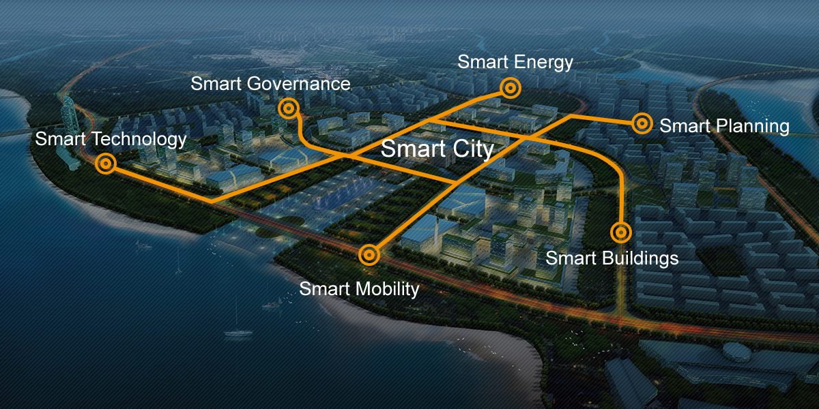
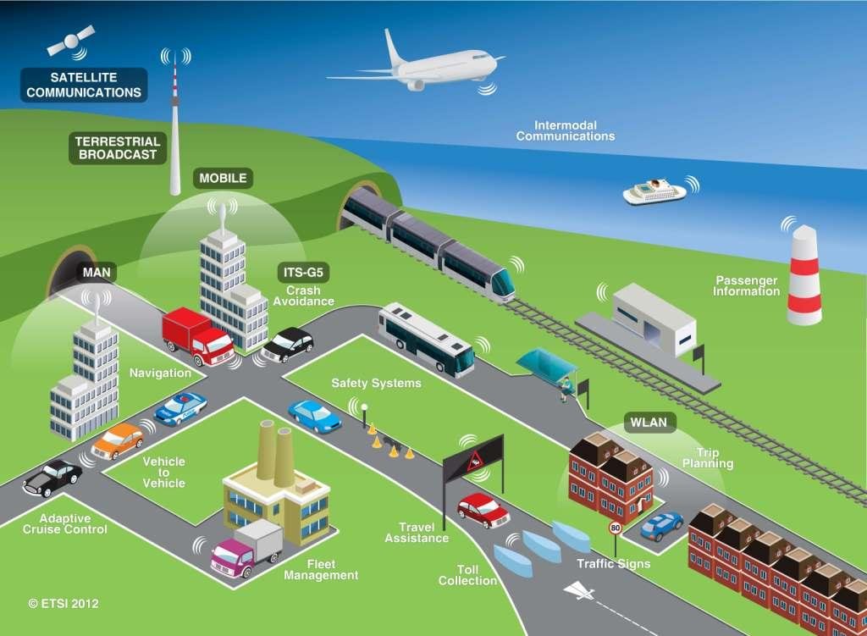

SDI is much more
Precise farming
Smart environment
Smart cities
Intelligent transportation

Slide 7
BESTSDI project
Application submitted: 08.02.2016.
Project launched: 15.10.2016.
Project closure: 14.10.2019.
Project coordinator:
  University of Zagreb, Croatia
Program country partners:
  Catholic University of Leuven, Belgium
  University of Split, Croatia
  Ss. Cyril and Methodius University in Skopje, N. Macedonia
  Bochum University of Applied Sciences, Germany

Slide 8
BESTSDI partners
Partner country partners:
  Polytechnic University of Tirana, Albania
  Agricultural University of Tirana, Albania
  University of Banja Luka, Bosnia and Herzegovina
  University of Mostar, Bosnia and Herzegovina
  University of Sarajevo, Bosnia and Herzegovina
  University of Tuzla, Bosnia and Herzegovina
  University for Business and Technology – UBT, Pristina, Kosovo
  Unviersity of Montenegro, Montenegro
  University of Belgrade, Serbia
  University of Novi Sad, Serbia
  University of “Ukshin Hoti” in Prizren, Kosovo

Slide 9
BESTSDI partners
Associated partners:
  Republic Administration for Geodetic and Property Affairs of Republic of Srpska, Bosnia and Herzegovina
  Federal Administration for Geodetic and Property Affairs of Federation of Bosnia and Herzegovina, Bosnia and Herzegovina
  Agency for Real Estate Cadastre, N. Macedonia
Sub-contractors:
  Lantmäteriet, Sweden
  Novogit, Sweden

Slide 10
BESTSDI objectives
The wider objectives of the BESTSDI project is to improve the quality of higher education in Geographical Science and Technology field, SDI enhance its relevance for the labour market and society aiming to improve the level of competences and skills in HEI's by developing new and innovative education programmes within the field of SDI.
These wider objectives are fully compliant with the priorities of the Capacity Building projects within the Erasmus+ program.

Slide 11
BESTSDI objectives
The specific project objectives are to develop, test and adapt new curricula, courses, learning material and tools within the field of SDI.
In doing so, existing undergraduate and graduate curricula’s in the academic institutions in the WB region will be lifted to higher levels, recognising the role of spatial data for modern society and its development.
By the incorporation of SDI concept and other modern concepts based on spatial data and information, the students of the new courses will have the ability to provide efficiently spatial data and services to SDI users.

Slide 12
BESTSDI objectives
In parallel, the project is also promoting SDI and related concepts among the bright spectrum of professionals, teachers and students raising awareness about the relevancy of SDI and cooperation necessity between key stakeolder groups (academia-business-public sector).

Slide 13
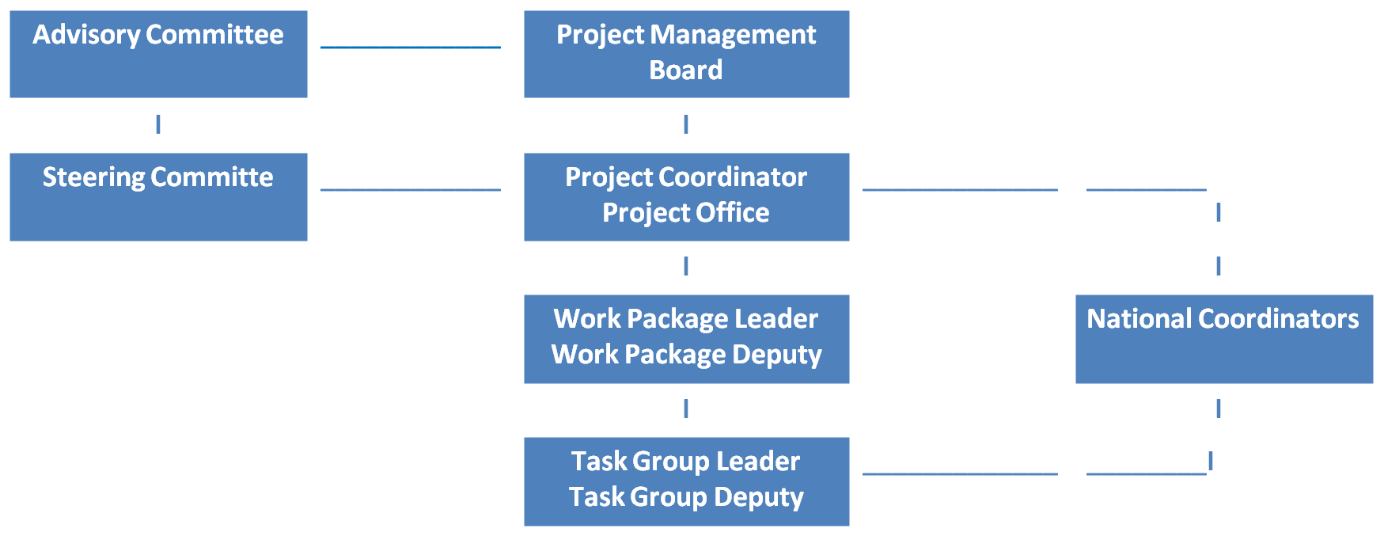
BESTSDI management organigram

Slide 14
BESTSDI project activities
Work packages:
WP1 – Preparation – Specification of the core curriculum
WP2a – Development – Development of curriculum
WP2b – Development – Implementation f curriculum
WP3 – Quality Plan
WP4 – Dissemination & Expoitation
WP5 - Management

Slide 15
BESTSDI expected results
To develop appropriate curricula, courses and their content for academic institutions.
To ensure human and technical capacities for this implementation (teachers and equipment)
To implement developed curricula in long-life learning programs for professionals
To disseminate the project experiences and results in order to create additional value and multiply the impact of the results.
To establish the necessary foundation for the participation of partner universities in the national and European SDI arena.

Slide 16
BESTSDI achieved results
In depth research on existing situation in WB has been conducted
80 teachers were trained though two summer schools in Split
15 SDI laboratories have been established and equipped with 300 pieces of ICT equipment and 20 pieces of sensor tools
Project SDI curriculum has been developed covering 10 themes and some 70 topic areas
15 Annual National SDI Reports have been produced
9 Project workshops and 2 conferences have been conducted with some 520 participants

Slide 17
BESTSDI achieved results
In 116 courses SDI content from developed curriculum has been lectured during the 3rd year of project lifetime for some 2.600 students attending them!

Slide 18
BESTSDI achieved results
Additionally, 36 LLL SDI courses have been conducted for several houndred of professionals

Slide 19
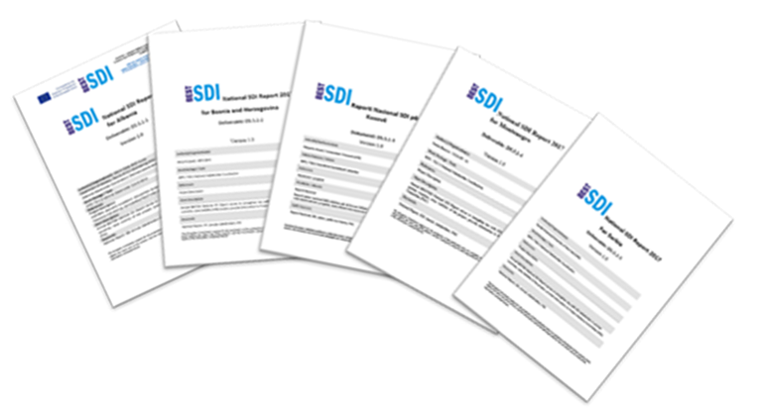
BESTSDI additional benefits
New level of communication and cooperation among the partner universities with the emphasis on SDI but expanding it on institutional and project cooperation.
New level of cooperation with NatRisk, NMCA’s, EuroSDR, etc.
New level of communication and cooperation among the SDI stakeholders on partner countries national level.
Web news: 40/108 37%
Journal news: 6/108 5%
Meeting: 20/108 19%
Invited lectures: 5/108 5%
Exhibition booth: 8/108 7%
Conference presentation: 14/108 13%
Journal paper: 6/108 5%

Slide 20
Instead of conclusion
There are still 42 days till the project closure
Lot of things are still to be done
Continuation of activities ensured through new GEOBIZ project
Sustainability plan based on established network give us opportunity further to develop our cooperation!

Slide 21


Thank you for your attention!
www.bestsdi.eu
info@bestsdi.eu
----
This project has been funded with support from the European Commission. This publication [communication] reflects the views only of the author, and the Commission cannot be held responsible for any use which may be made of the information contained therein.

